Slide 1

Midterm Rabina Aryal

Slide 2
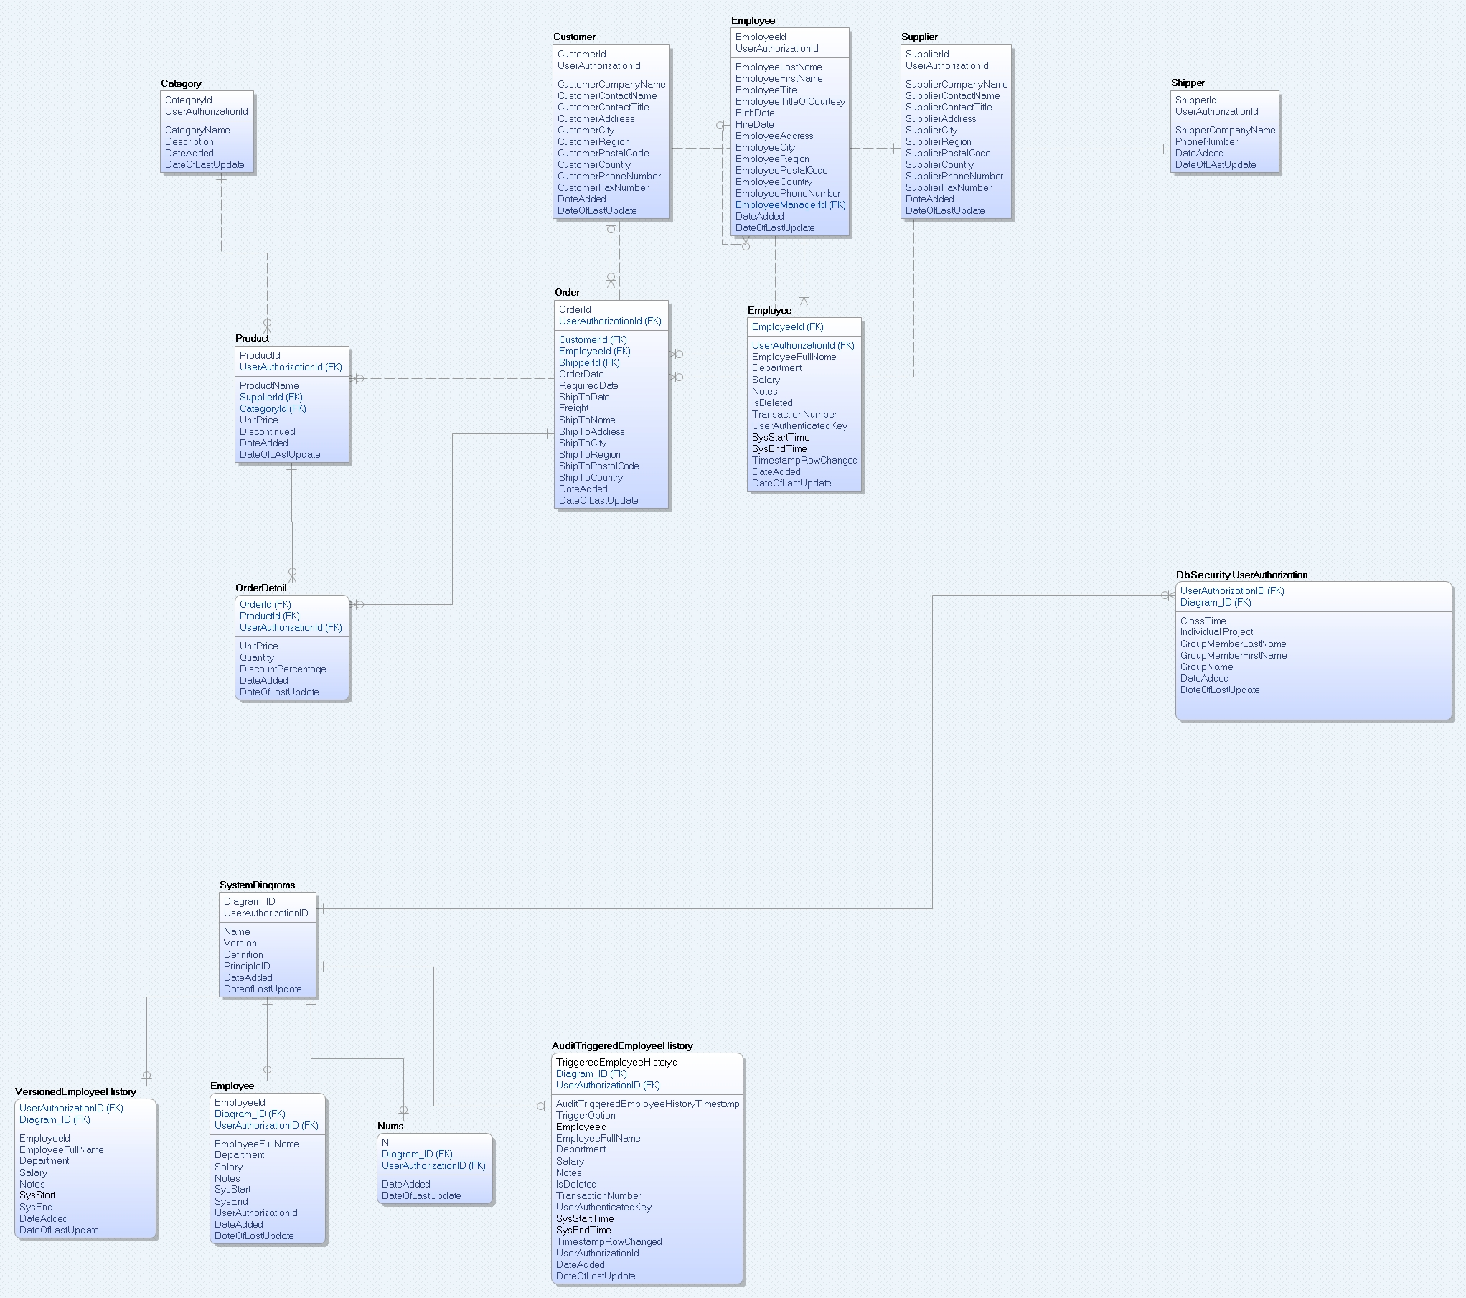
Creating 1 to 1 relation between the tables

Slide 3
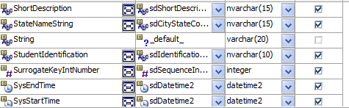
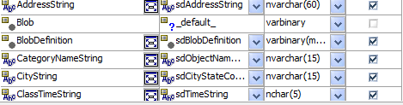
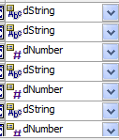
Domain Parent
New Domain Parent: sdDatetime2, sdTimeString, sdYearString.
Repeated Domain Parent

Slide 4
Why I choose those datatype?
I used default datatype because it was already there, and I could change it the way I wanted.
I choose datatype integer for domain SurrogateKeyIntNumber because surrogate key is a uniquely indexed number, and it uniquely defines the row.
Sometimes I used string datatype because I needed string value.
I used integer datatype when I was working with numbers.
When I needed datetime value I used datetime datatype.

Slide 5
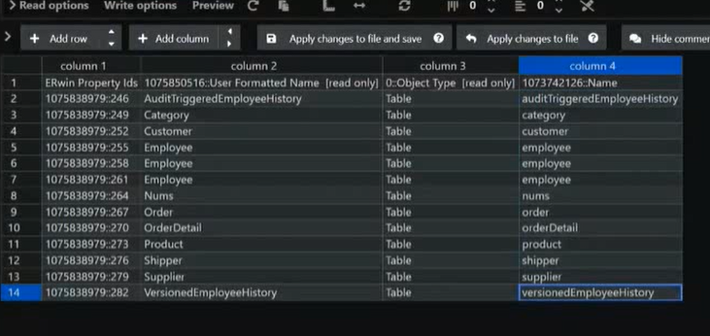
Refining UDT
This is how I was changing my convention to camelCase using the VS code

Slide 6
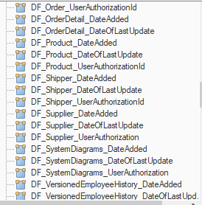
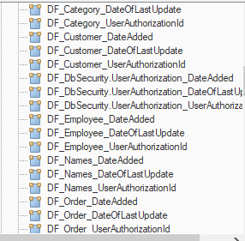
Added Default value to the root domain
I’ve added UserauthrizationId, DateAdded and DateOfLastUpdate on root domain on the database

Slide 7
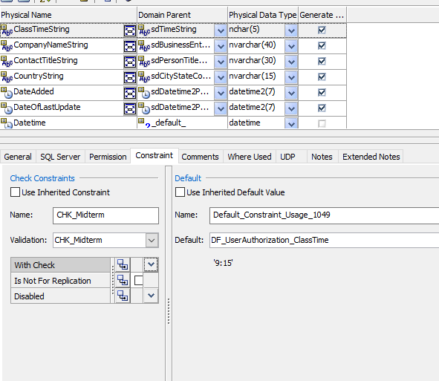
Constraints with default value
I have set a constraint to ‘9:15’ to the misterm domain

Slide 8
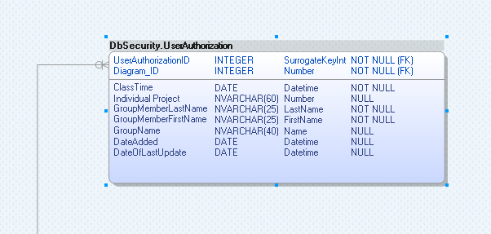
Creating Dbsecurity.UserAuthorization

Slide 9
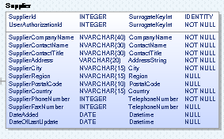
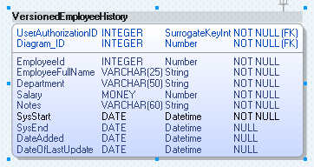
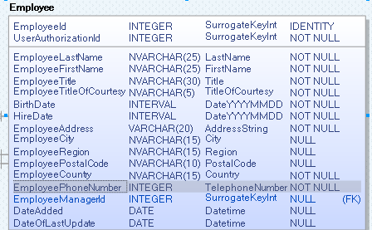
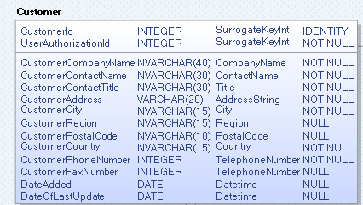
Altering all tables and adding some new columns to the tables

Slide 10
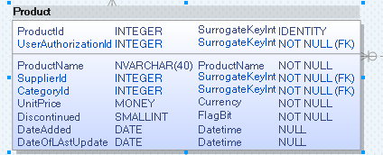
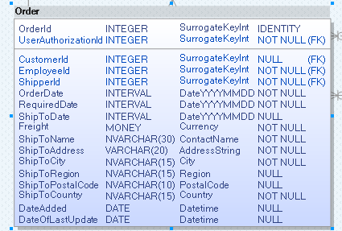
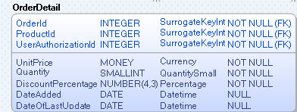
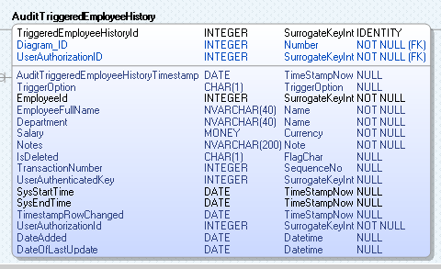
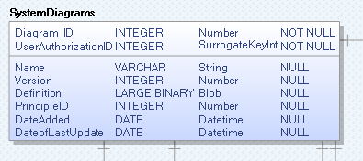

Slide 11
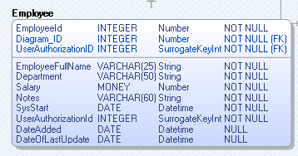
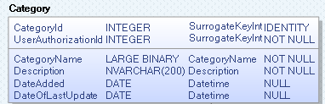
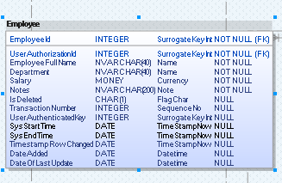
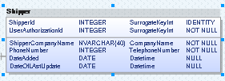
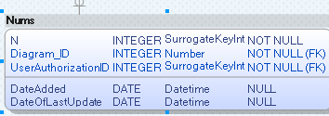
Continued…..

